Slide 1
Chapter 1 figures

Slide 2
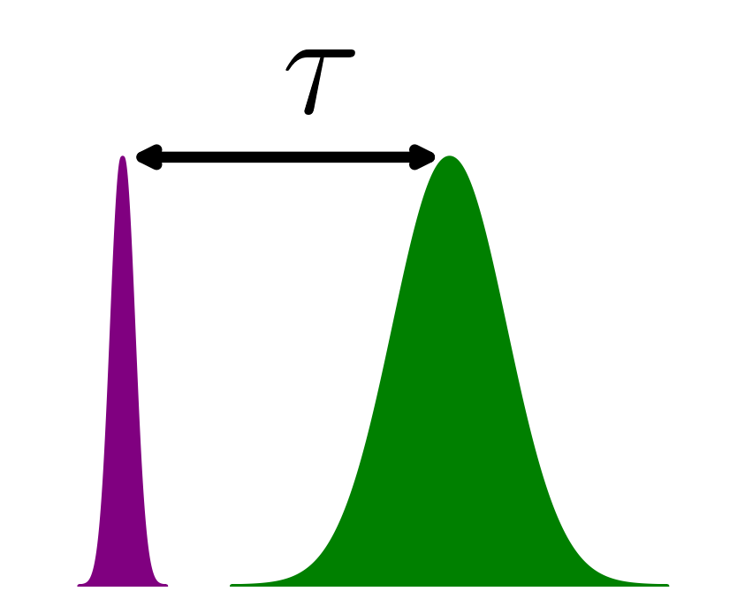
CB
E_{F}
MIR
VB
XUV
XUV
MIR
3d_{5/2}
core
3d_{3/2}

